Slide 1
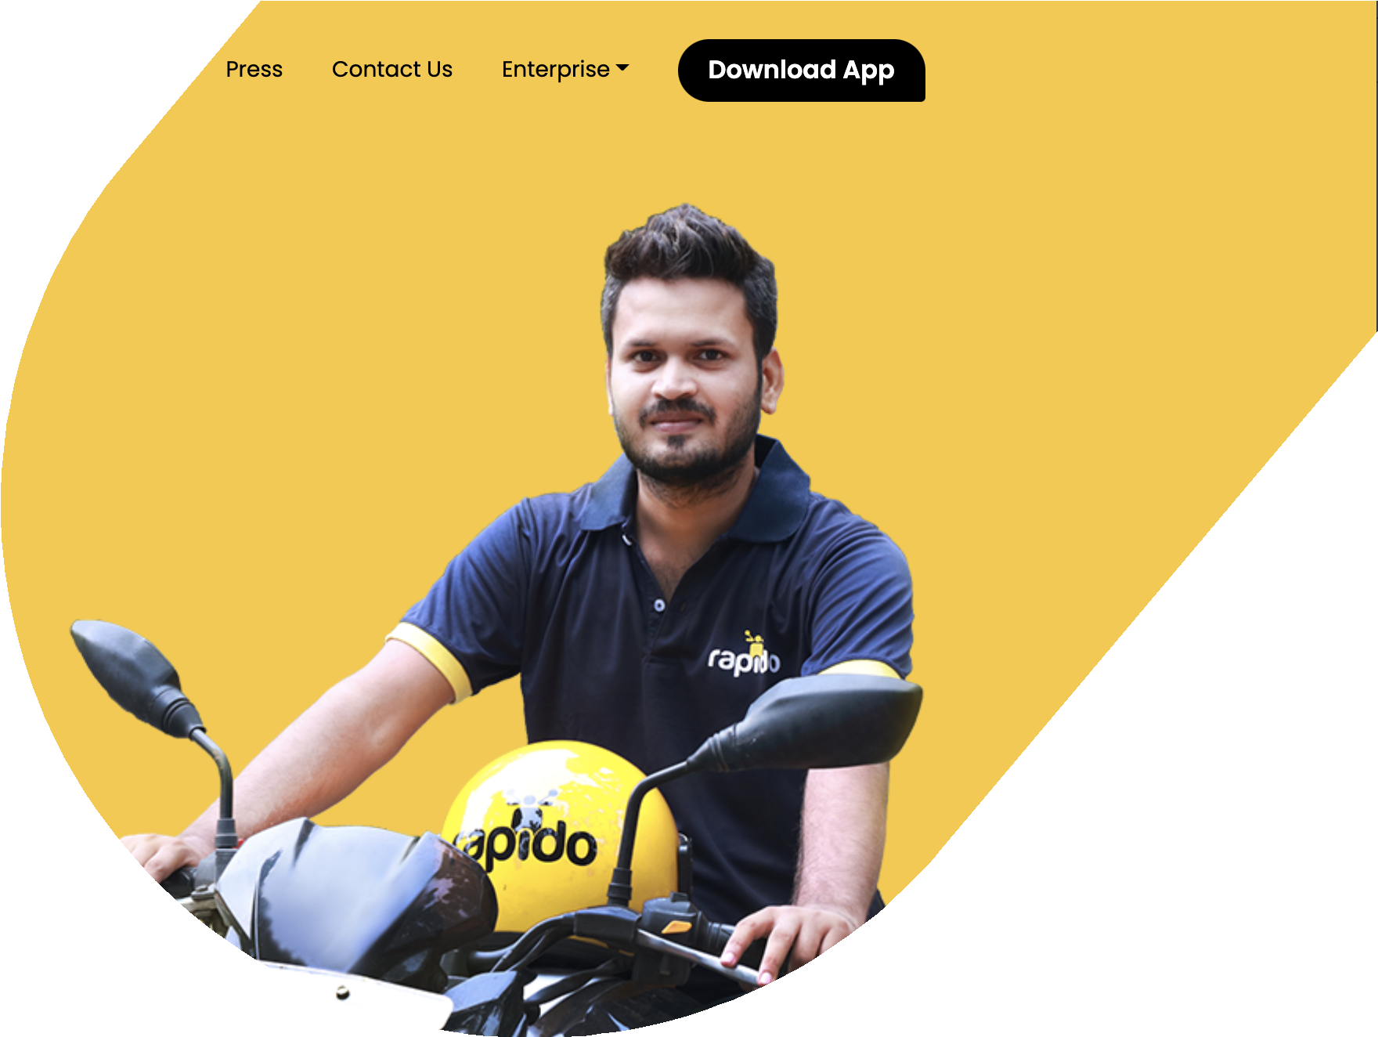

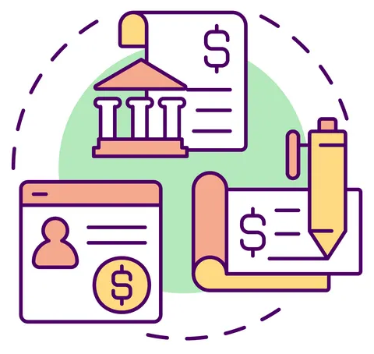

RAPID RISE OF RAPIDO
INDIAN INSTITUTE OF TECHNOLOGY,
KANPUR
End Term Project
For
IITK Consulting Group
SUBMITTED BY:
Prerna Singh Chauhan 210767
Sneh Omer 211041

Slide 2



About Rapido
One of the largest Indian bike taxi applications and one of the smartest startups of India
Founded in 2015, by Aravind Sanka, Pavan, and Rishikesh
Offers low-cost bike taxi rides through registered riders called “Captains”
Targets 200 and below ticket size segment taxi market
Prominent investors are Pawan Munjal (Chairman, Hero MotoCorp), Rajan Anandan (Former Google India Head)
Plans to expand the business model to tier2 and tier3 cities
The goal is to make Rapido an easy and affordable commute alternative
100+
Indian cities where Rapido is present
20%
Market share in the ride-sharing segment
20M
Registered users
0.4M+
Rides per day
60k+
Active Captains across the country
25M
App downloads
CATEGORY
Transportation
HEADQUARTERS
Bengaluru
Notes:
Starting with the presentation, Rapido is one of the largest Indian bike taxi applications and one of the smartest startups of India. It was founded in 2015 by Aravind Sanka, Pavan and Rishikesh in Bengaluru. The Unique Selling Proposition of Rapido is that it offers low-cost bike taxi rides through registered riders called “Captains”. It targets 200 and below ticket size segment taxi market.
It operates in over 100+ urban locations across the country with having a market share of 20% and has the vision to resolve last-mile network problems. According to sources from September 2018, this bike taxi start-up has more than 15,000 enrolled riders, with daily average rides of 30,000. Aravind Sanka, a fellow founder of Rapido, claimed that the company had created more than 500,000 jobs in India as of 2019. The organization claimed to have one crore clients in November 2019.
It also plans to expand its business model to tier2 and tier3 cities.
Rapido is distinguishing itself and achieving syndication like status in this field where various participants are clashing or falling apart.

Slide 3

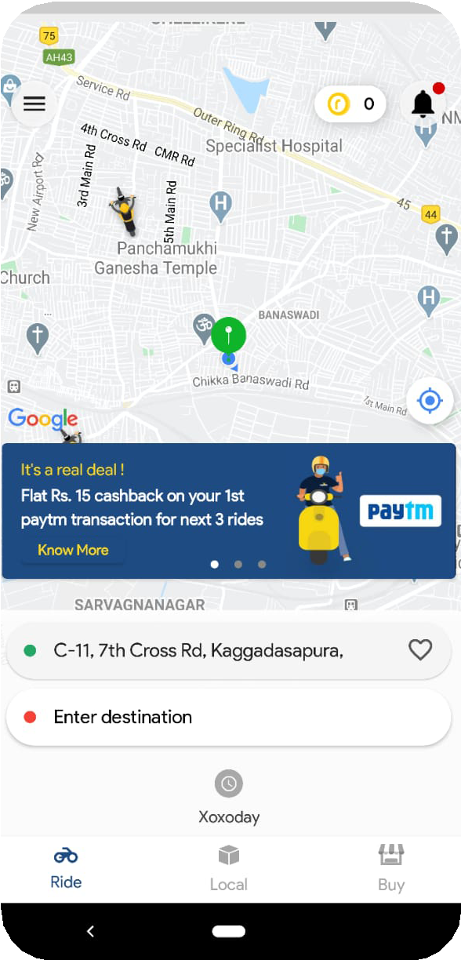







Business/Revenue Model of Rapido
Users book a ride in the app
Registered riders(Captain) get registered through Rapido Captain App
Captains use vehicles like scooters, bikes, or e-bikes
Base fare of Rs 15 in addition to Rs 3 for every kilometer of the ride
Rapido’s revenue model has 2 major aspects – commission and B2C commission
Commission-based: Rapido charges 20% of the total fare
Rapido Store: Rapido earns via B2C logistics by helping businesses deliver their commodities (Ex-Swiggy, Myntra, Eat.fit, Delhivery, etc.)
Notes:
Rapido’s revenue model has 2 major aspects – commission and B2C commission In the commission based, Rapido charges 20% of the total fare. Rapido earns via B2C logistics by helping businesses deliver their commodities (Ex-Swiggy, Myntra, Eat.fit, Delhivery, etc.)
Let us talk about how it works?

Slide 4
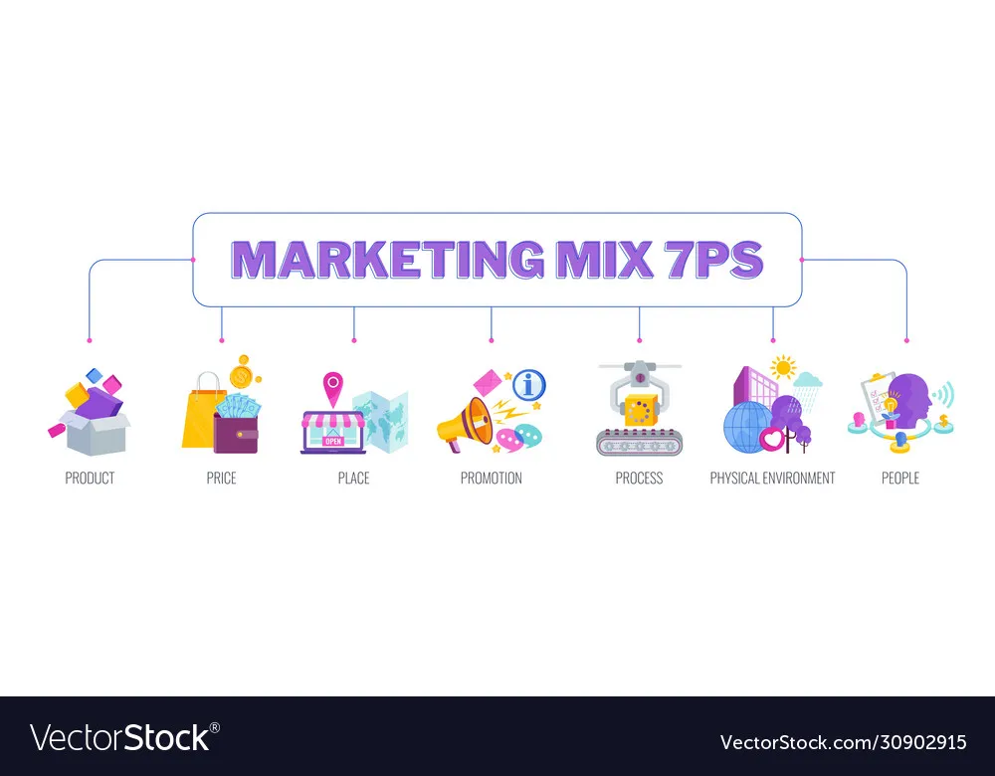
Marketing Mix for Rapido
Affordable bike-taxi rides
Mobile app in various languages, operates in 100+ cities
Less expensive than cab rides and share taxis
Ranveer Singh, Allu Arjun, Rajkumar Rao, Jiiva as brand ambassadors Cashback on wallet payment, Online and offline marketing campaign
Daily & middle-class commuters, students, travelers
Taps the already present 2-wheeler vehicles as captains, connects them with customers
Customer care service, In-app issue tickets, affordability

Slide 5




Competitor Analysis
 | Rapido | Vogo | Bounce | Drivezy | Yulu
Logo
Founding Year | 2015 | 2016 | 2014 | 2015 | 2017
Location (cities) | 100+ | 5 | 3 | 50 | 6
Revenue | $12M | $4M | $1M | $3M | $6M
Funding | $316M | $191M | $214.2M | $150M | $110M
Customer Base | 25M | 12 M | 20M | 5M | 3M
Product Categories | Bike-Taxi | Self-driven Rental | Self-driving scooters | Rental business | Micro Mobility Vehicles
Value Proposition | Reliable, convenient, affordable short rides | Two free helmets per scooter, safety | No human intervention, collect and go | Reliable, convenient and hassle free commute | Reliable, convenient, and affordable commute

Slide 6
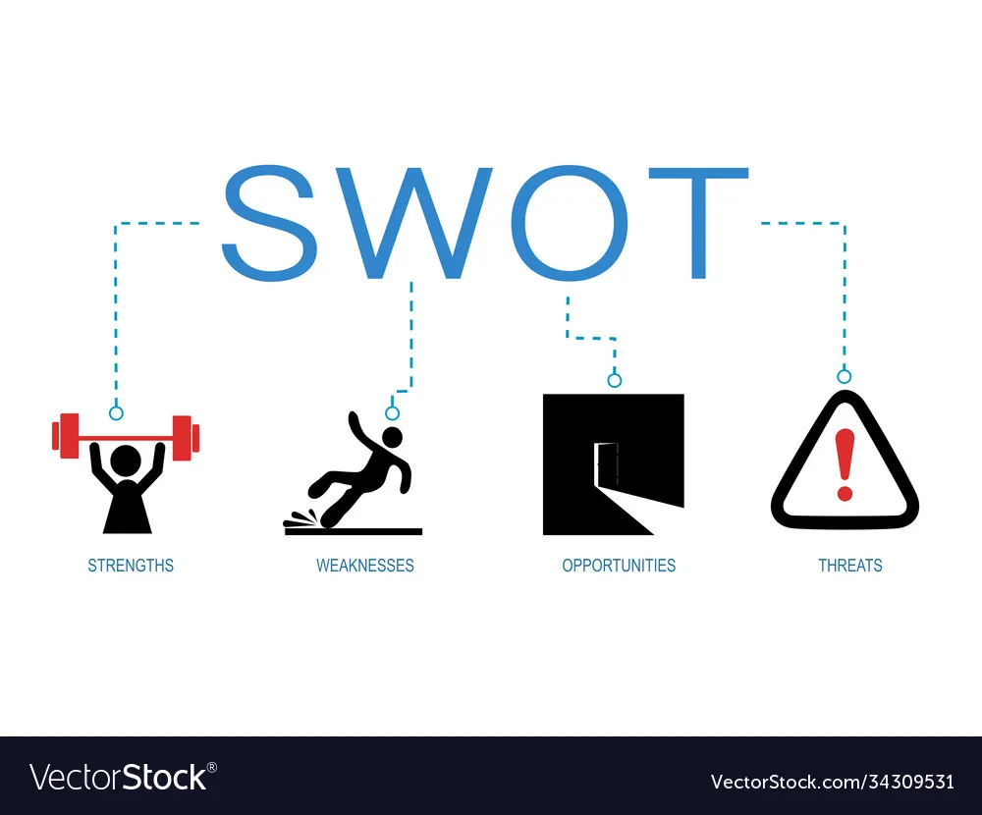
SWOT Analysis
Affordable & quickest commute rides
User-friendly app, multiple languages, speed tracking for captains
Tabbed onto the existing in-efficiency of already bought 2-wheelers market
Low burn rate and hence huge fleet of riders
Marketed as vehicle pooling on a cost-sharing basis instead of bike-taxi to evade regulatory hurdles
Still there’s a lack of appreciation for bikes as the quickest commute
Less professional etiquette of Captains
Bike is not considered to be a safe or comfortable ride option
Huge growth of the Indian middle-class
Rising demand for quick commute alternatives instead of expensive cabs
Expansion prospects in Tier2 and Tier3 cities
“Rapido-Corp” a unique product for office-going employee communities in Tier-1 cities
Capturing the ‘bike rental’ market segment initially at the top tourist locations
Emerging competitors in the bike taxi segment
Rising fuel prices
Strict government policies toward safety measures
Unavoidable circumstances
Notes:
Strengths- • It is far less expensive and hence affordable to common people. • Rapido provides quickest commute rides and is very useful during horrifying rush hours, when public transports becomes very time consuming.• About the Rapido app- It is an easy to use app that is user friendly operating in multiple languages with speed tracking options.• Very good option for those having driving or parking issues( Rapido drivers are handelling those hussles)Weakness-• There’s a lack of appreciation for bikes as the quickest commute. • Due to several threatening cases that had occurred, bike rides are not considered as a safer or comfortable option. In that case consumers prefer to use public transports or their personal vehicles.• Sometimes the less professional etiquette of Captains is also one of the factors that discourage the consumers.• It has still not proved to be a safer or preferable option for the Women segment of consumers.Opportunity-• There is a huge market of two wheelers in India which is actually underutilized . From a large population of Bike owners , many of them are either unemployed part time workers or students . Also the rare seats of 80% of the bikes on roads are vacant. Rapido can extend its business in this segment providing easily accessible rides to the customers.• Public transportation in India is slow and does not cover important locations as frequently as required. Due to crowded roads, there is a waste of a lot of time and with two-wheelers it becomes easy to navigate through both traffic and traffic rules. • it can enlarge their market in tier-2 and tier-3 cities of India.• “Rapido-Corp” a unique product for office-going employee communities in Tier-1 cities.• There is also opportunity in the top tourists locations where they can provide Bike Rental services to the tourists and expand their market segment.Threats-• With emerging competitors in the bike taxi segment, it will be incredibly challenging for Rapido to compete in the existing market.• There are situations where the consumer are nor provided protective helmets or have complains about the captain.• Women are the potential customers and many of them feels bike taxi segment is not a women friendly service which will be a threat to the company.• Many people complain about frequent cancellation of rides by the drivers that creates a negative mindset of consumers.

Slide 7

Customer Value Proposition
Functional
Symbolic
Economical
Proposition
Leading bike-taxi firm
Forbes Under 30 - Asia - Consumer Tech 2019
Hassle-free commute
Quick travel
Ease of use – Rapido App
Emotional
Cheapest mode of taxi rides
Efficient & Pocket-friendly
Last-mile commute
Highly recommended by customers
Captains bonus points based on customer rating
Notes:
Customer Value Proposition- It refers to a simple statement that communicates, in a few words, why a customer would want to choose your product or service over your competitors

Slide 8

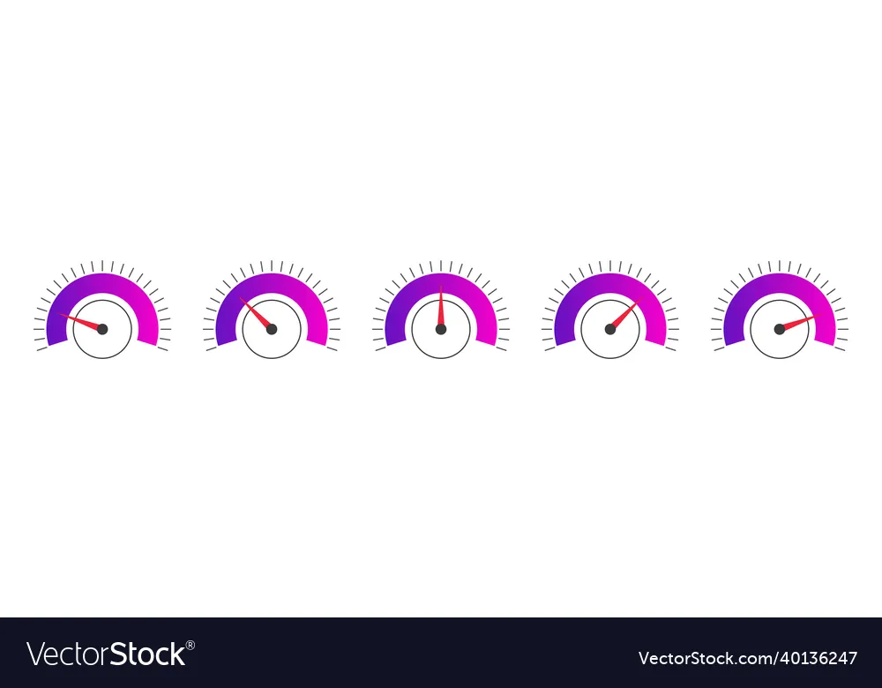

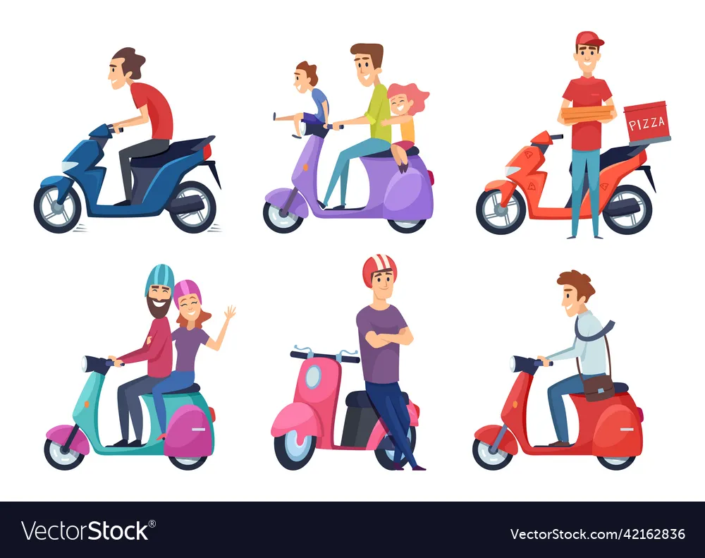
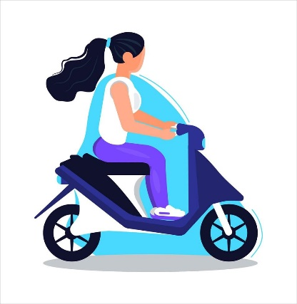
Market Research
There are 220 million bike owners in India
20% of them are unemployed, part-time workers, or students
20%
Average bike utilization in a day is just 18%
No need to encourage new purchase
LOW
Declining growth rate of expensive cab rides
Bike taxis can generate $5 billion/year
Rapido is trying to utilize the existing in-efficiency
80% of the bikes on roads have a vacant rear seat
Huge opportunity available for female riders
Only 5% of captains are female for 20% of the female customers

Slide 9
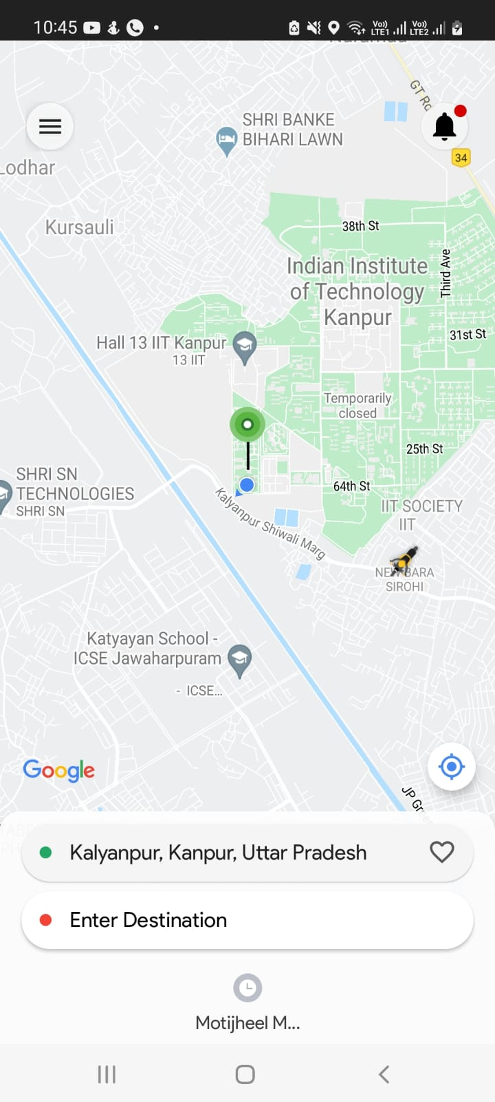
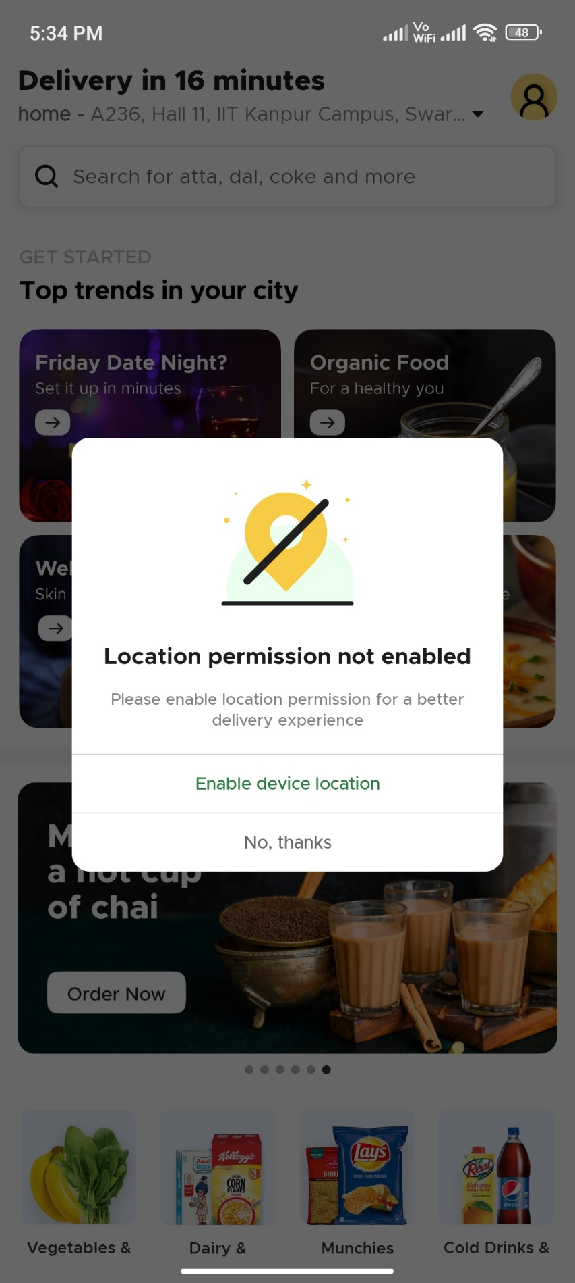



Observations/Analysis
Challenges
Uncaptured Tier-2 and Tier-3 market
High Competition
Entry barrier low- New Competitors
Female customers are low due to low female captains
Absence in growing youth segment of self-drive bikes
Do you wish to continue with our female captain?
Yes, Continue
Solutions
Target fast-growing tier 2 cities like Nashik, Ajmer, Durgapur, etc.
Break gender-stereotype and include female captains
Option to select Female captains for female customers
‘Power Pass’ for daily commuters - Discounts
Power Pass

Slide 10
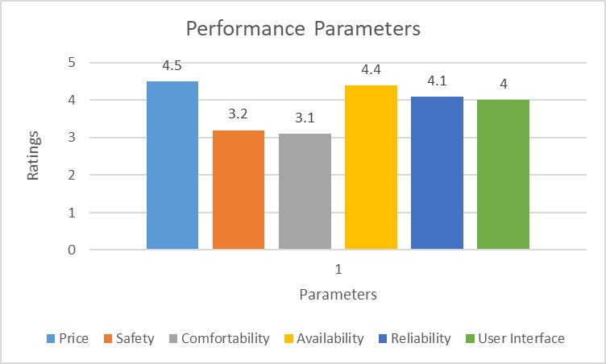
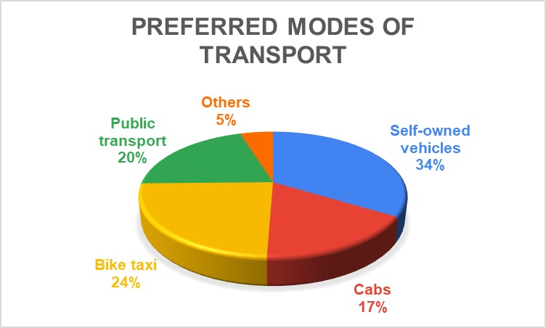
Insights from customer survey
Customer survey on Performance Parameters
Customer Survey on Modes of transport
Customers are highly satisfied with the pricing
Need to work and promote safety measures
Customers are satisfied with the availability and reliability of Captains
Easy-to-use application interface
Majority of people use personal vehicles
Bike taxis are preferred next to personal vehicles
It is clear that bike taxis are preferred over cabs and autos
If we increase the reach of Rapido in tier 2&3 cities we will be able to increase market share of Rapido

Slide 11







Measures
Constant speed-tracker to send automated alerts on high-speeding
Riders would get fewer bonus points for more alert history
Safety Measures
Helmets, license, and first-aid box to be mandatory for Captains
Good customer feedback on safety can enhance bonus points
Rapido can provide loan support to promote more new captains
Instant cash withdrawal on daily basis instead of weekly/monthly

Slide 12
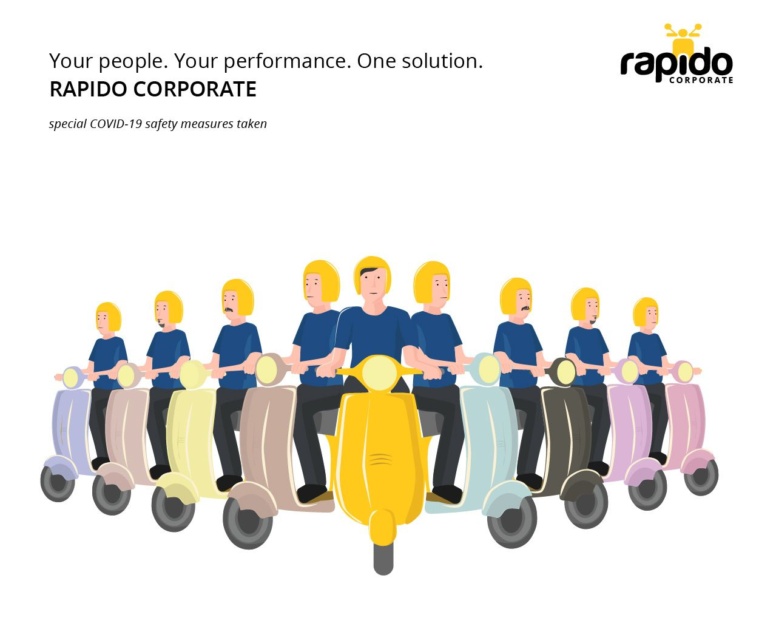
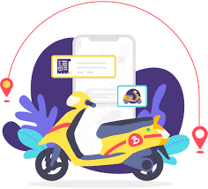

Solutions
Rapido Corp
-Tapping the office-going employees through ride-sharing and earning opportunities
-Working professionals as ‘Rapido-Host’
-Auto-debit and multiple payment options through wallet due to daily use
Self-drive Bike Rental
-Tapping the office-going employees through ride-sharing and earning opportunities
-Working professionals as ‘Rapido-Host’
-Auto-debit and multiple payment options through wallet due to daily use
Ooty
Mysore
“Our motto is to use the existing vehicles and create employment for the underemployed. Our product highly attracts part-timers and gives much more flexibility for the captains” -- Co-Founder and CEO, Aravind Sanka

Slide 13
Marketing Strategy in Tier 2 and Tier 3
ATL
TV
TTL
Social Media
Events in School/Colleges
BTL
Email Marketing such as newsletter subscription
Newspaper/Press
Billboards
Merchandising such as distribution of cups/T-shirts
Posters

Slide 14

References
https://www.rapido.bike/About
https://www.crunchbase.com/organization/rapido/technology
https://marqueex.com/marketing-strategy-of-rapido/#Brand_campaign
https://www.thehindu.com/business/rapido-targets-to-more-than-double-user-base/article38176173.ece
https://www.forbes.com/profile/rapido/?list=30under30-asia-consumer-technology&sh=360a23e57303
Interaction with Rapido daily commuters
THANK
YOU
HAVE A GREAT DAY !

